Slide 1
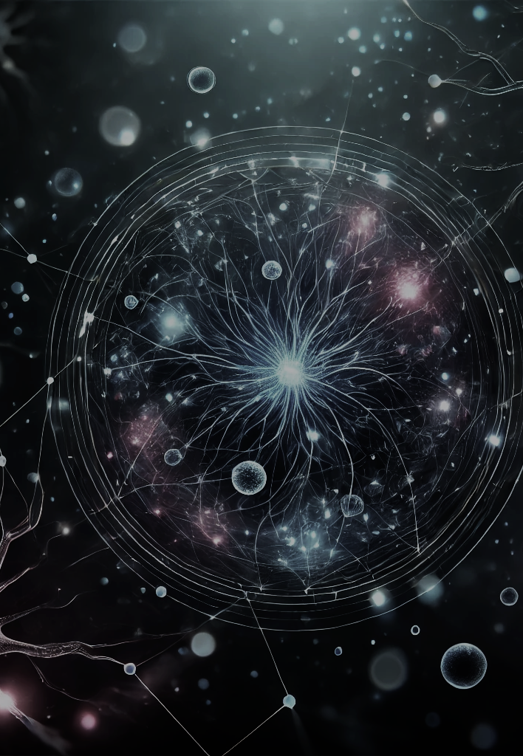

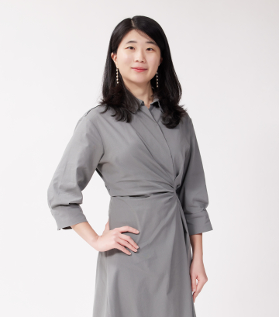
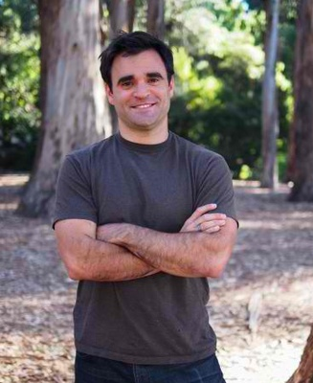
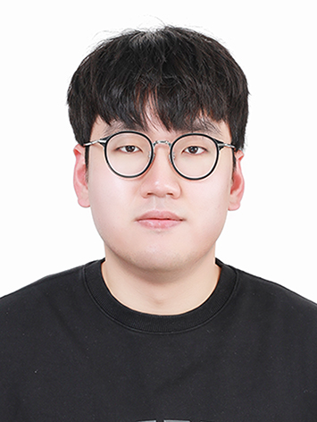
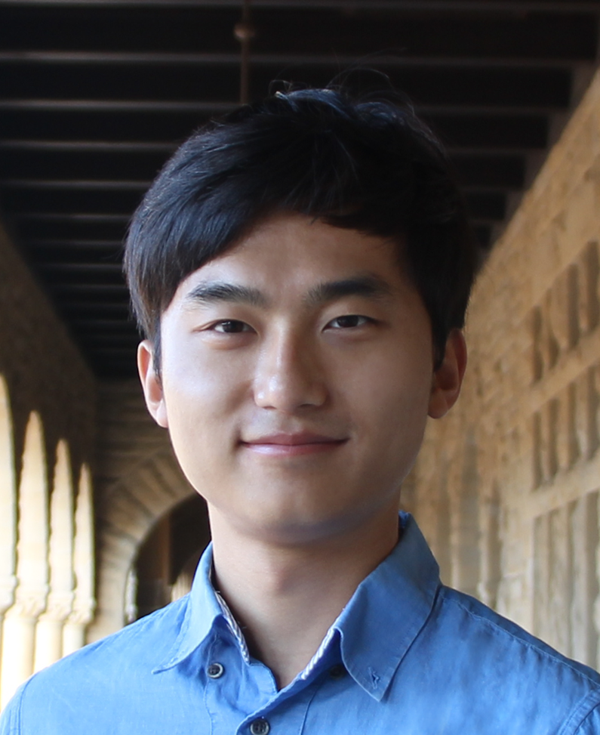
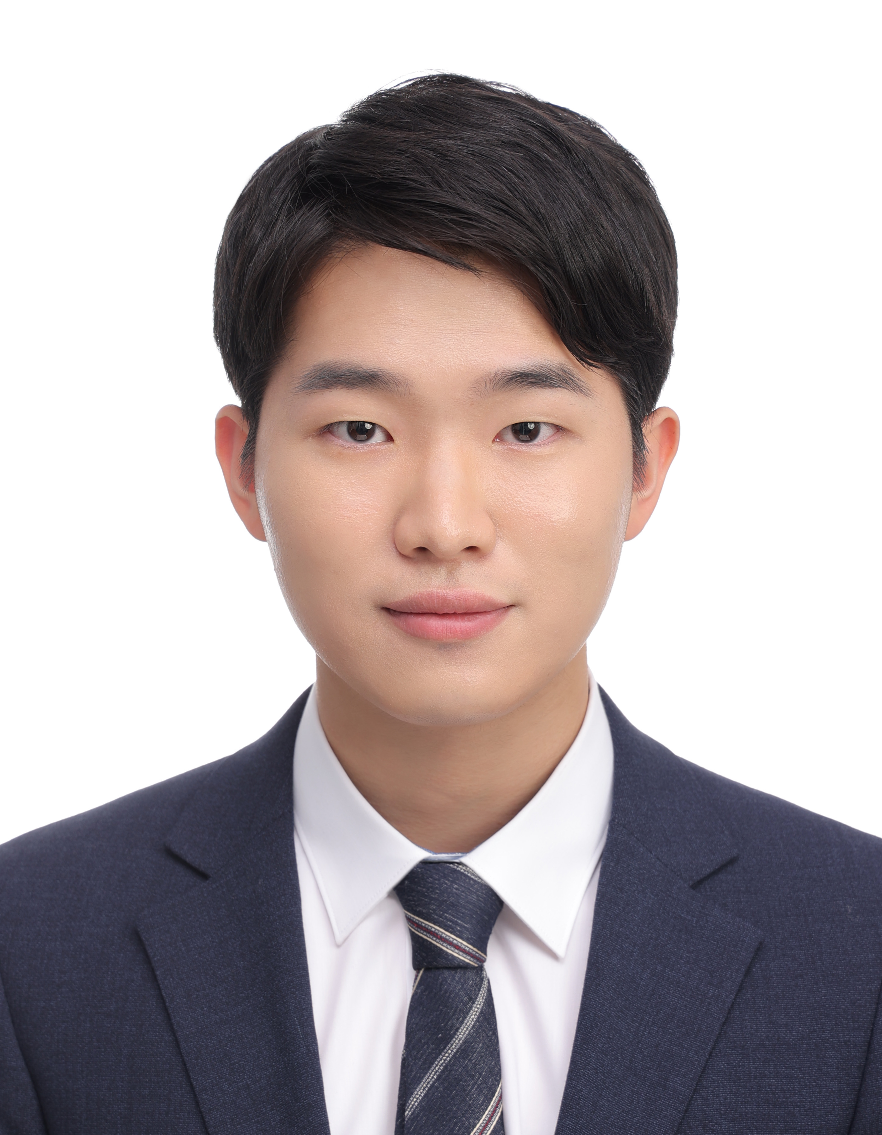
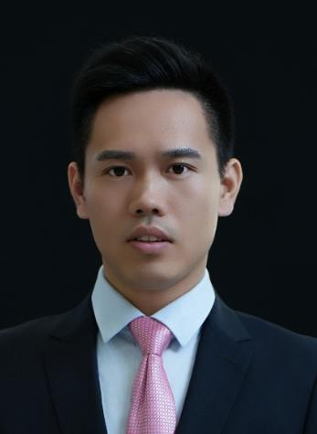
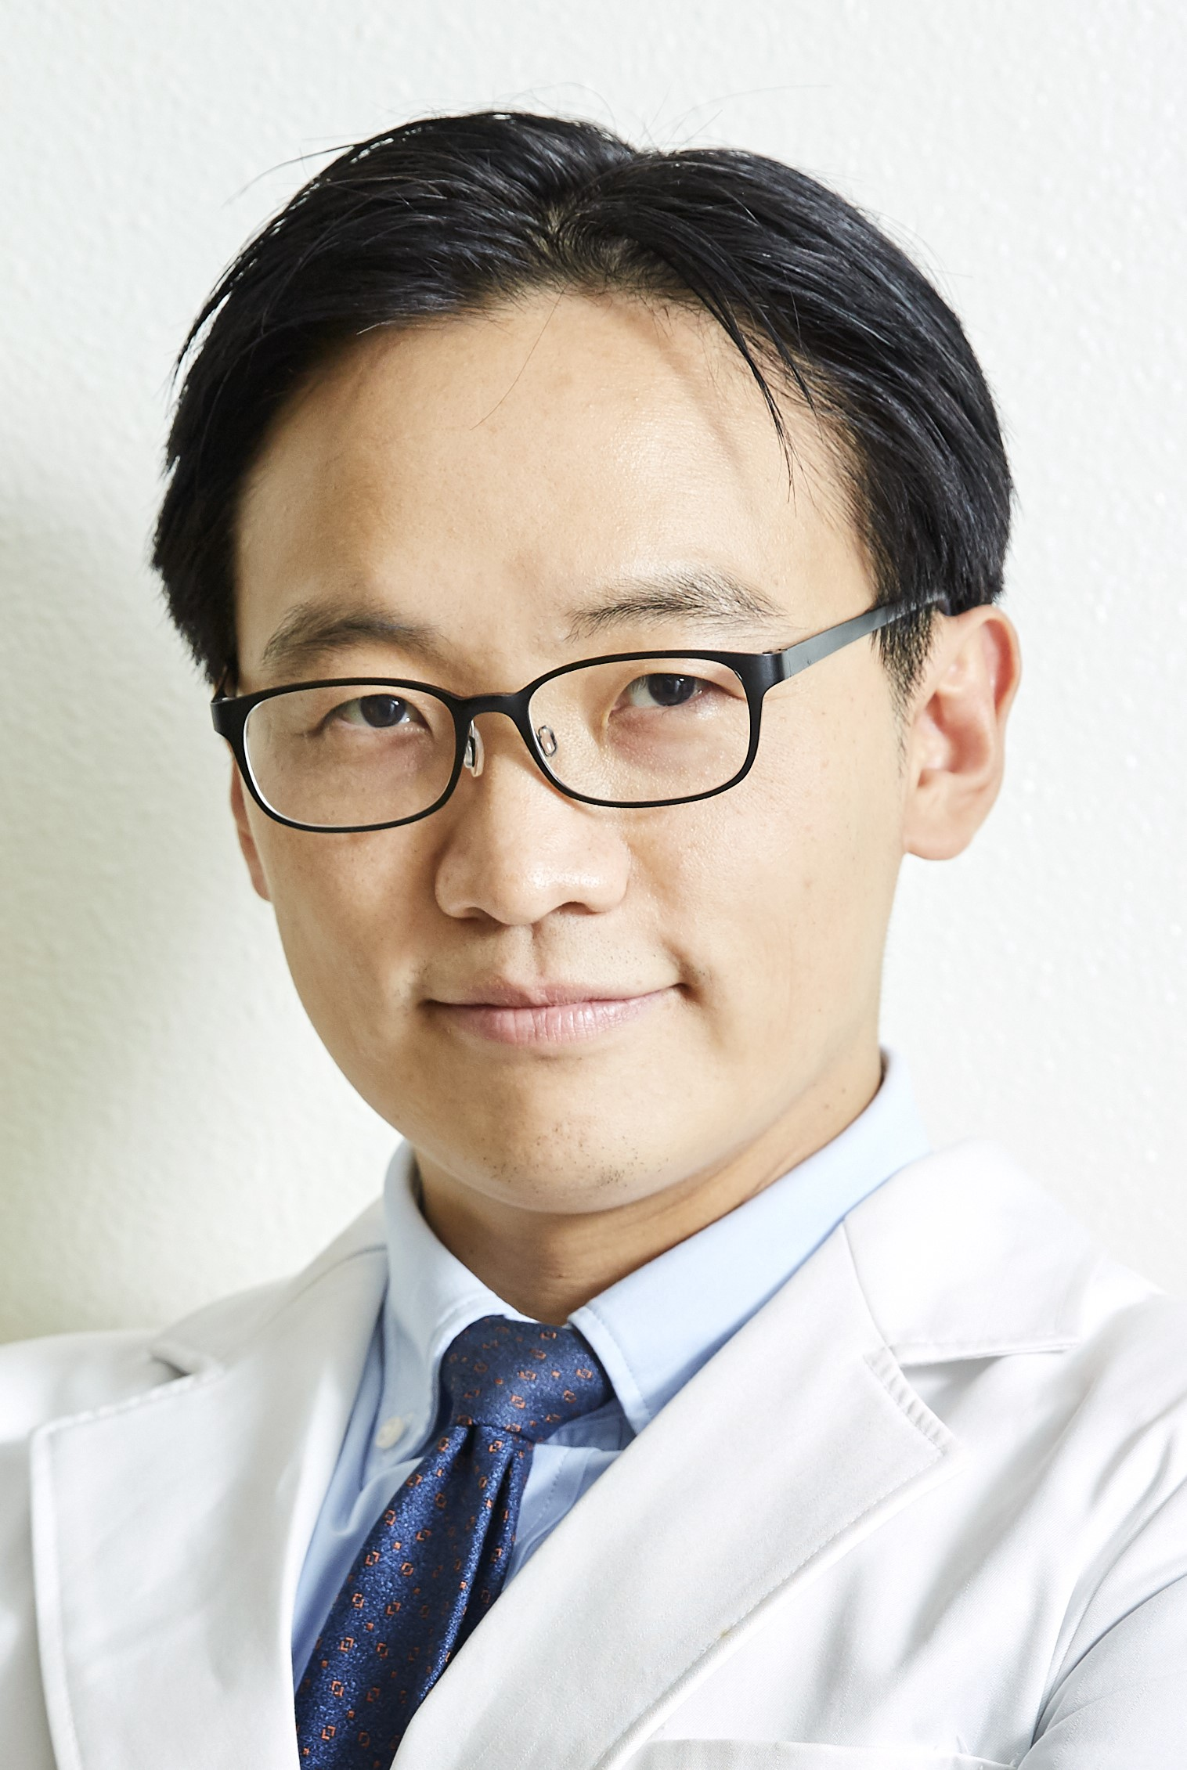
2025 KSBNS
Educational Session 01
Title: Optical Techniques in Neuroscience
Molecular and circuit-level understanding of memory and memory related disorders
August 25th (Monday), 10:35-13:00
Room 104-106, Songdo CONVENSIA, Incheon, Korea
Registration KSBNS2025.org
Organizer
Hyeyoung Shin
Assistant Professor, School of Biological Sciences, Seoul National University
Description
: In this workshop, we aim to introduce cutting-edge optical methods in neuroscience, including neural manipulation (two-photon holographic optogenetics and patterned stimulation) and recording techniques (miniature endoscopes). This workshop will feature an overview of the techniques and neuroscientific applications from leading investigators (Dr. Hillel Adesnik and Dr. Hyungjin Choi), as well as practical hands-on knowledge from expert users of these techniques.
Photograph
Speakers
Hillel Adesnik
Associate Professor, Department of Neuroscience, University of California, Berkeley
“Probing neural codes with two-photon holographic optogenetics”
Description : His research aims to understand the logic and syntax of the neural codes of perception. He has pioneered novel high-speed and spatially precise optical approaches to manipulate neural activity at the level of single neurons in the intact brains of awake, behaving animals.
Ilsong Choi
Postdoc, Dr. Seung-Hee Lee’s Lab, KAIST
“Applying two-photon imaging and stimulation in mouse cortex ”
Description : His research explores the neural mechanisms underlying multisensory decisions, uncovering how locomotion alters sensory dominance and how learning reshapes inhibitory circuits involved in these decisions in behaving mice.
YoungJu Jo
Postdoc, Dr. Karl Deisseroth’s Lab, Stanford University
“Optical, molecular, and computational approaches for next-generation holographic optogenetics”
Description : His research focuses on developing and applying advanced neurotechnology for AI-driven discovery and control of neural computations. He recently discovered cell-type-specific and brain-wide line attractors integrating reward history.
Jongmin Yoon
Graduate Student, Dr. Myunghwan Choi’s Lab, Seoul National University
“Widefield patterned optogenetic stimulation”
Description : His research focuses on revealing the properties of neural networks and populations, supported by his developments on novel methods for high-speed/data-efficient voltage imaging, neural network analysis, and genetic labeling.
Runlong Wu
Professor and doctoral advisor at Beijing Information Science and Technology University.
“Miniature two-photon microscopy for freely moving animals”
Description : Dr. Wu’s research focuses on the development of advanced in vivo imaging technologies. His team has developed a series of miniaturized two-photon microscopes and was among the first to achieve stable, high-resolution imaging of neurons and synapses in the brains of freely behaving mice.
Hyung Jin Choi
Professor, Department of Brain and Cognitive Sciences,
“Single-cell neural activity imaging in freely moving mice”
Description : His research focuses on the neuronal control of eating behavior, energy need, motivation, pleasure, and utility. Using miniature endoscopes, he recently discovered hypothalamic circuits that encode appetite and GLP-1-induced satiation.

